Slide 1
How Science Can Directly Relate to Public Health Guidelines and Health Inequities
Alexander Bruckhaus
4th year Computer Science/Business
Student @ USC
USC Mark and Mary Stevens Neuroimaging and Informatics Institute
Keck School of Medicine of USC
University of Southern California

Slide 2
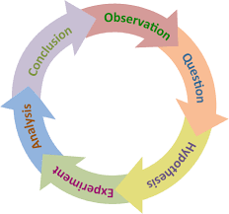
What do we mean by “science”?
Science = Knowledge
USC Mark and Mary Stevens Neuroimaging and Informatics Institute
Keck School of Medicine of USC
University of Southern California

Slide 3
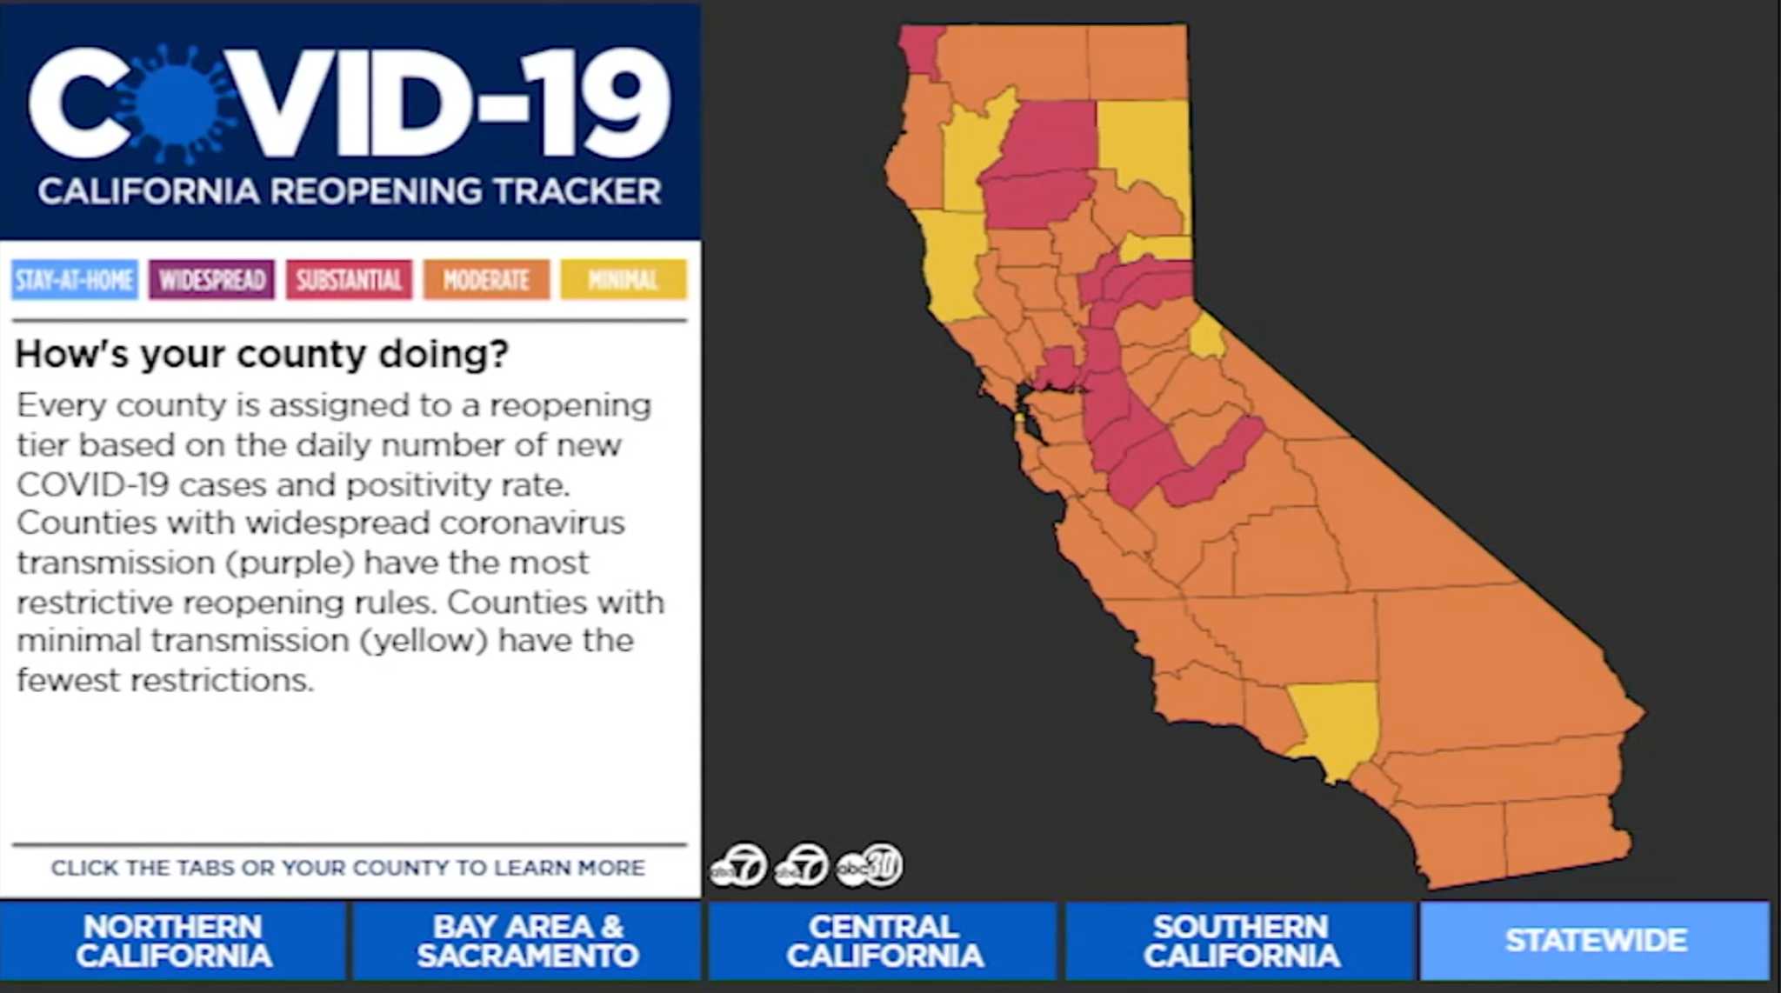
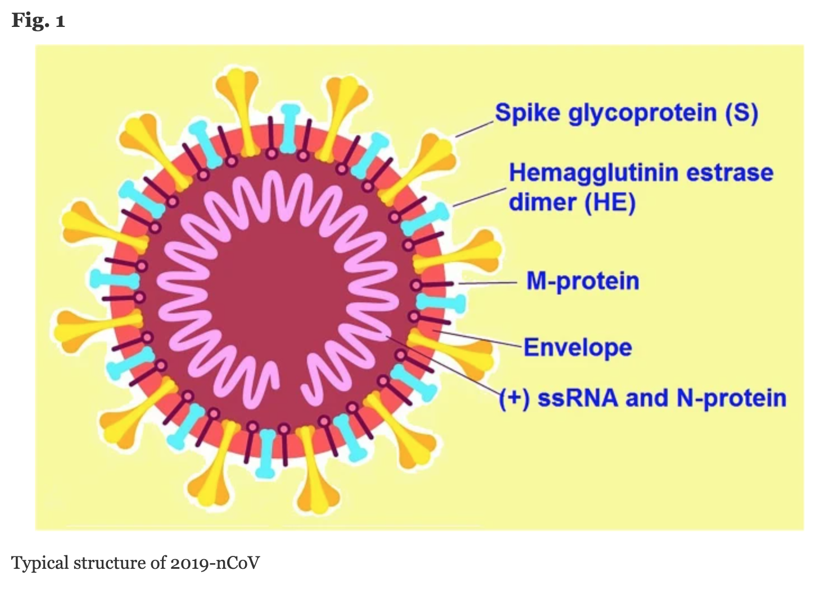
COVID-19 public health policy and scientific research
https://abc7news.com/california-stay-at-home-regions-covid-icu-capacity-shelter-in-place-bay-area-lockdown/6393906/
https://biologicalproceduresonline.biomedcentral.com/articles/10.1186/s12575-020-00128-2
USC Mark and Mary Stevens Neuroimaging and Informatics Institute
Keck School of Medicine of USC
University of Southern California

Slide 4
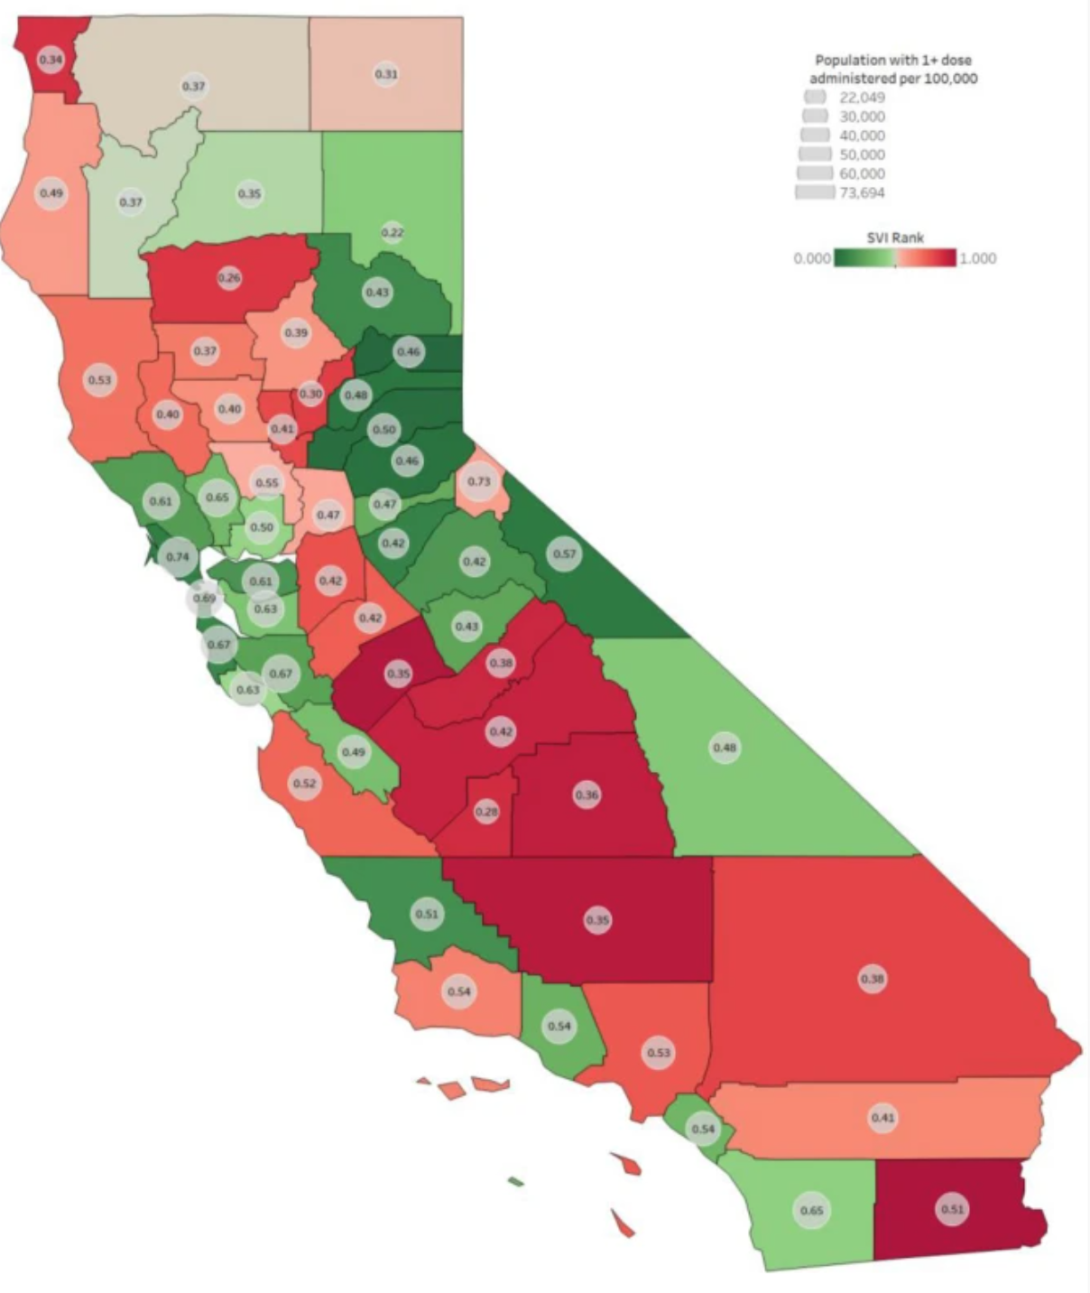
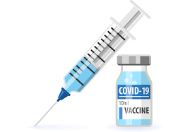
COVID-19 health inequities and scientific research
https://link.springer.com/article/10.1007/s10903-021-01308-2
USC Mark and Mary Stevens Neuroimaging and Informatics Institute
Keck School of Medicine of USC
University of Southern California

Slide 5
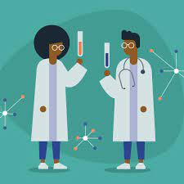
Final Thoughts
Always be curious and always ask questions! You can make a difference in the world if you do both!
USC Mark and Mary Stevens Neuroimaging and Informatics Institute
Keck School of Medicine of USC
University of Southern California

